Slide 1
Insights and Applications

Slide 2
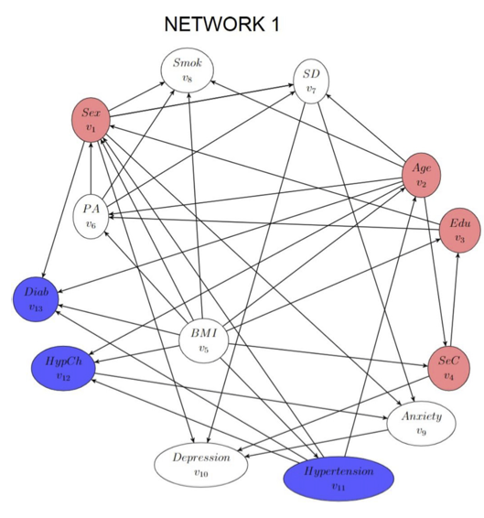
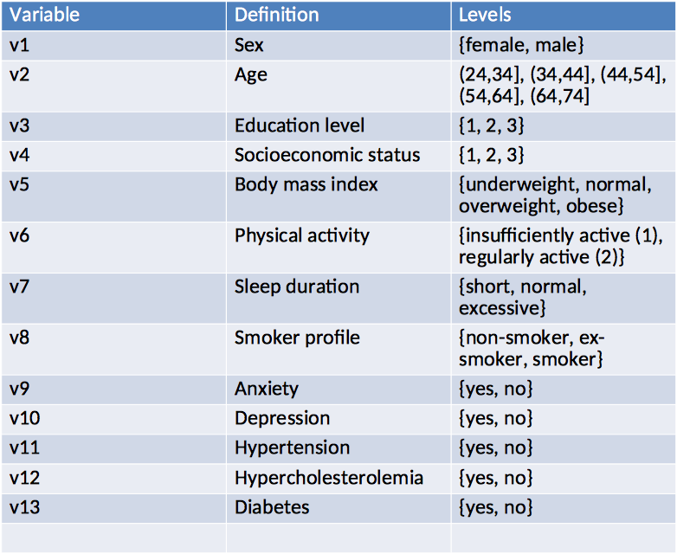
Building the Bayesian Network
Variables in model

Slide 3
Building the Bayesian Network
Data:
Source: Annual health assessments (2012–2016), 205,087 cleaned records.
Variables: Non-modifiable (e.g., age, sex), Modifiable (e.g., BMI, smoking, activity), Medical conditions (e.g., hypertension, diabetes).
Methodology:
Structure Learning: Greedy Thick Thinning (GTT) algorithm for dependencies.
Expert Refinement: Added 15 edges, reversed 7 connections.
Probability Estimation: Multinomial-Dirichlet with uniform priors.
Validation: 5-fold cross-validation achieving predictive accuracies of 91–93%.

Slide 4
Key Findings and Use Cases
Individual Predictions:
Personalized risk assessment for medical conditions.
Example: Assessing hypertension risk in sedentary, overweight individuals.
Population Insights:
Socioeconomic status influences risk (e.g., hypertension, diabetes).
Supports targeted public health strategies.
Intervention Analysis:
Example: Regular physical activity reduces hypertension likelihood by ~25%.

Slide 5
Enhancements and Broader Applications
Dynamic Modeling: Track changes in risk factors over time.
Expanded Scope: Include diverse populations for generalizability.
New Variables: Add diet, alcohol use, and genetics for richer predictions.
Real-Time Data: Integrate wearable devices and electronic health records.
Cost-Effectiveness Analysis: Evaluate financial implications of interventions.

